Slide 1
GET- ME -
THROUGH
19/10/2023
DAA PROJECT PRESENTATION
By - Aditya Choudhury & Adwaith PJ

Slide 2

DAA PROJECT
About The Project
Get-Me-Through-
Get-Me-Through is a cutting-edge system designed to streamline event attendance tracking, offering organizers and attendees a seamless and secure experience.
High - Level Goals and Objectives
Efficient Attendance Management
Enhanced User Experience
Data Analysis and Insights
Security and Data Integrity
Adaptability to Modern Event Formats
Environmental Sustainability

Slide 3
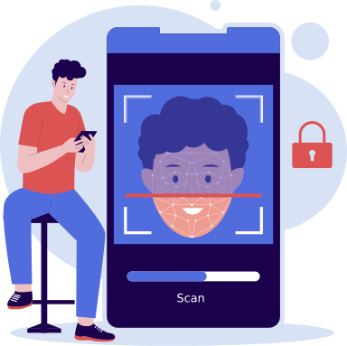
DAA PROJECT
App Features
Core Features
User Registration and Login
Event Management
Real-time Attendance Tracking
Face Recognition with TensorFlow
Real-time Data Synchronization with Firebase

Slide 4

DAA PROJECT
Technology Stack Used
Technology Stack and Implementation
MongoDB
Vite + ReactJS
Node/ExpressJS
Python & pylibs
Storing data related to user accounts, events, and attendance records.
Creating a responsive and intuitive user interface.
Handling authentication, event management, and attendance tracking.
Implementing accurate and efficient face recognition.
Firebase
Ensuring real-time data updates and synchronization for both attendees and organizers.

Slide 5

DAA PROJECT
Challenges Encountered
Real-time Facial Recognition: Overcoming resource-intensive processes for swift face recognition.
Data Synchronization with Firebase: Coordinating real-time data updates across multiple devices for consistent data.
Security and Privacy Concerns: Ensuring the protection of sensitive facial data and user information.
Environmental Factors in Face Recognition: Adapting the system to varying environmental conditions for accurate recognition.
Challenges

Slide 6
DAA PROJECT
Solutions
Implemented
Employing optimized deep learning models for speedy recognition.
Leveraging Firebase for seamless data updates and authentication.
Implementing robust security measures and encryption techniques for data protection.
Incorporating preprocessing techniques and robust machine learning algorithms for accurate recognition in diverse conditions.
Solutions

Slide 7

DAA PROJECT
Lessons Learned
1. The importance of careful planning and architecture design to ensure the system's efficiency and scalability.
2. The significance of user education to promote data privacy and security.
3. The need for ongoing testing and fine-tuning, especially in real-world scenarios.
4. The benefits of collaboration and teamwork in addressing complex challenges.
5. The value of user feedback in refining the user experience and system functionality.
6. The importance of staying up to date with the latest technologies and best practices in event attendance managem
About The Analysis

Slide 8

DAA PROJECT
Conclusion
Conclusion
In essence, 'Get-Me-Through' redefines event attendance management with real-time face recognition and robust data handling. Prioritizing user security and feedback, it emphasizes eco-friendly practices, underscoring the importance of careful planning, testing, and technological innovation.

